Slide 1
UNIT III

Slide 2
Syllabus
Fuzzy Systems and Applications:
Fuzzy sets;
fuzzy reasoning,
fuzzy inference systems,
fuzzy control,
fuzzy clustering,
applications of fuzzy systems.

Slide 3
Motivation
Conventional techniques for system analysis are intrinsically unsuited for dealing with systems based on human judgment, perception & emotion.

Slide 4
Fuzzy Systems
A system becomes a fuzzy system when its operations are entirely or partially governed by fuzzy logic or are based on fuzzy sets.

Slide 5
Fuzzy system design steps
Knowledge acquisition
Translate into the language of fuzzy inference, composing fuzzy rules, and designing fuzzy variables
Developing the basic fuzzy inference algorithm, filling the gaps by appropriate selections, and designing heuristic elements
Simulation and testing

Slide 6
Knowledge acquisition
Fuzzy system starts with obtaining the conventional method of solution.
This is called the knowledge acquisition process.
Conventional method of solutions are
Articulated expertise of the human operator, such as explaining how to ride a bike (natural language)
Recorded performance data (numerical data)
Closed-form mathematical formula

Slide 7
Translation
The design challenge is to translate the knowledge given in one of these forms into fuzzy IF-THEN form.
Expertise articulated in natural language is readily compatible with fuzzy IF-THEN rules.
Knowledge in the form of recorded performance represent a more difficult case for translation into fuzzy IF-THEN form. There are approximate methods for translation from the numerical data domain into IF-THEN language.
Translating a mathematical expression into fuzzy IF-THEN rules is also not very easy. A closed-form formula may contain knowledge that cannot be expressed by natural language. In such a case, the application of fuzzy set theory produces a fuzzy mathematical solution instead of a translation into fuzzy inference language. Examples are fuzzy arithmetic and fuzzy graph theory.

Slide 8
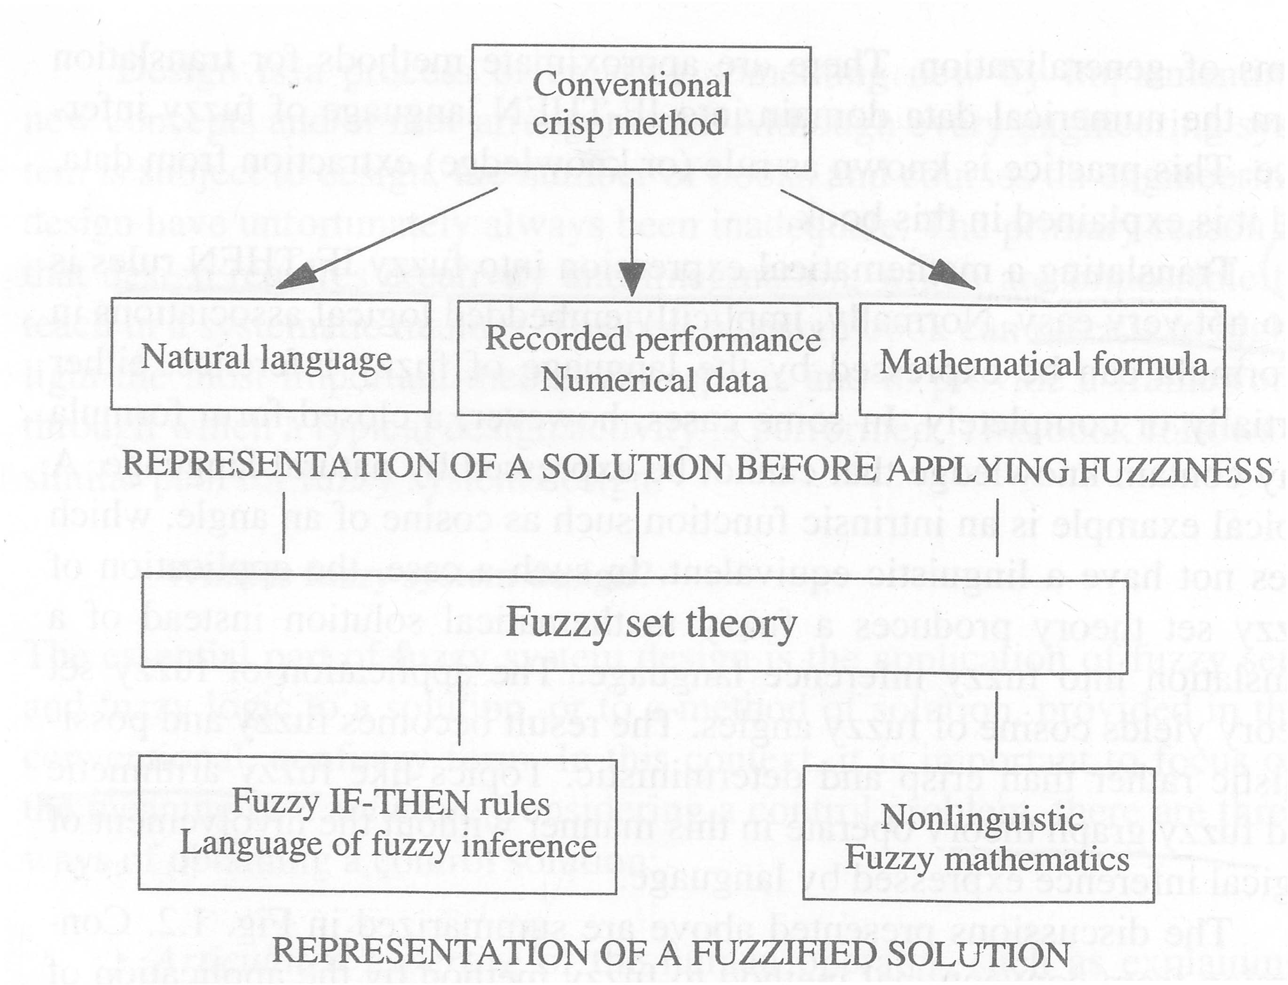
Converting a conventional method into a fuzzy method

Slide 9
Developing the basic fuzzy inference algorithm
Basic fuzzy inference algorithm, which is a skeleton of work flow to be filled with designable elements, sometimes requiring selection from multiple options.

Slide 10
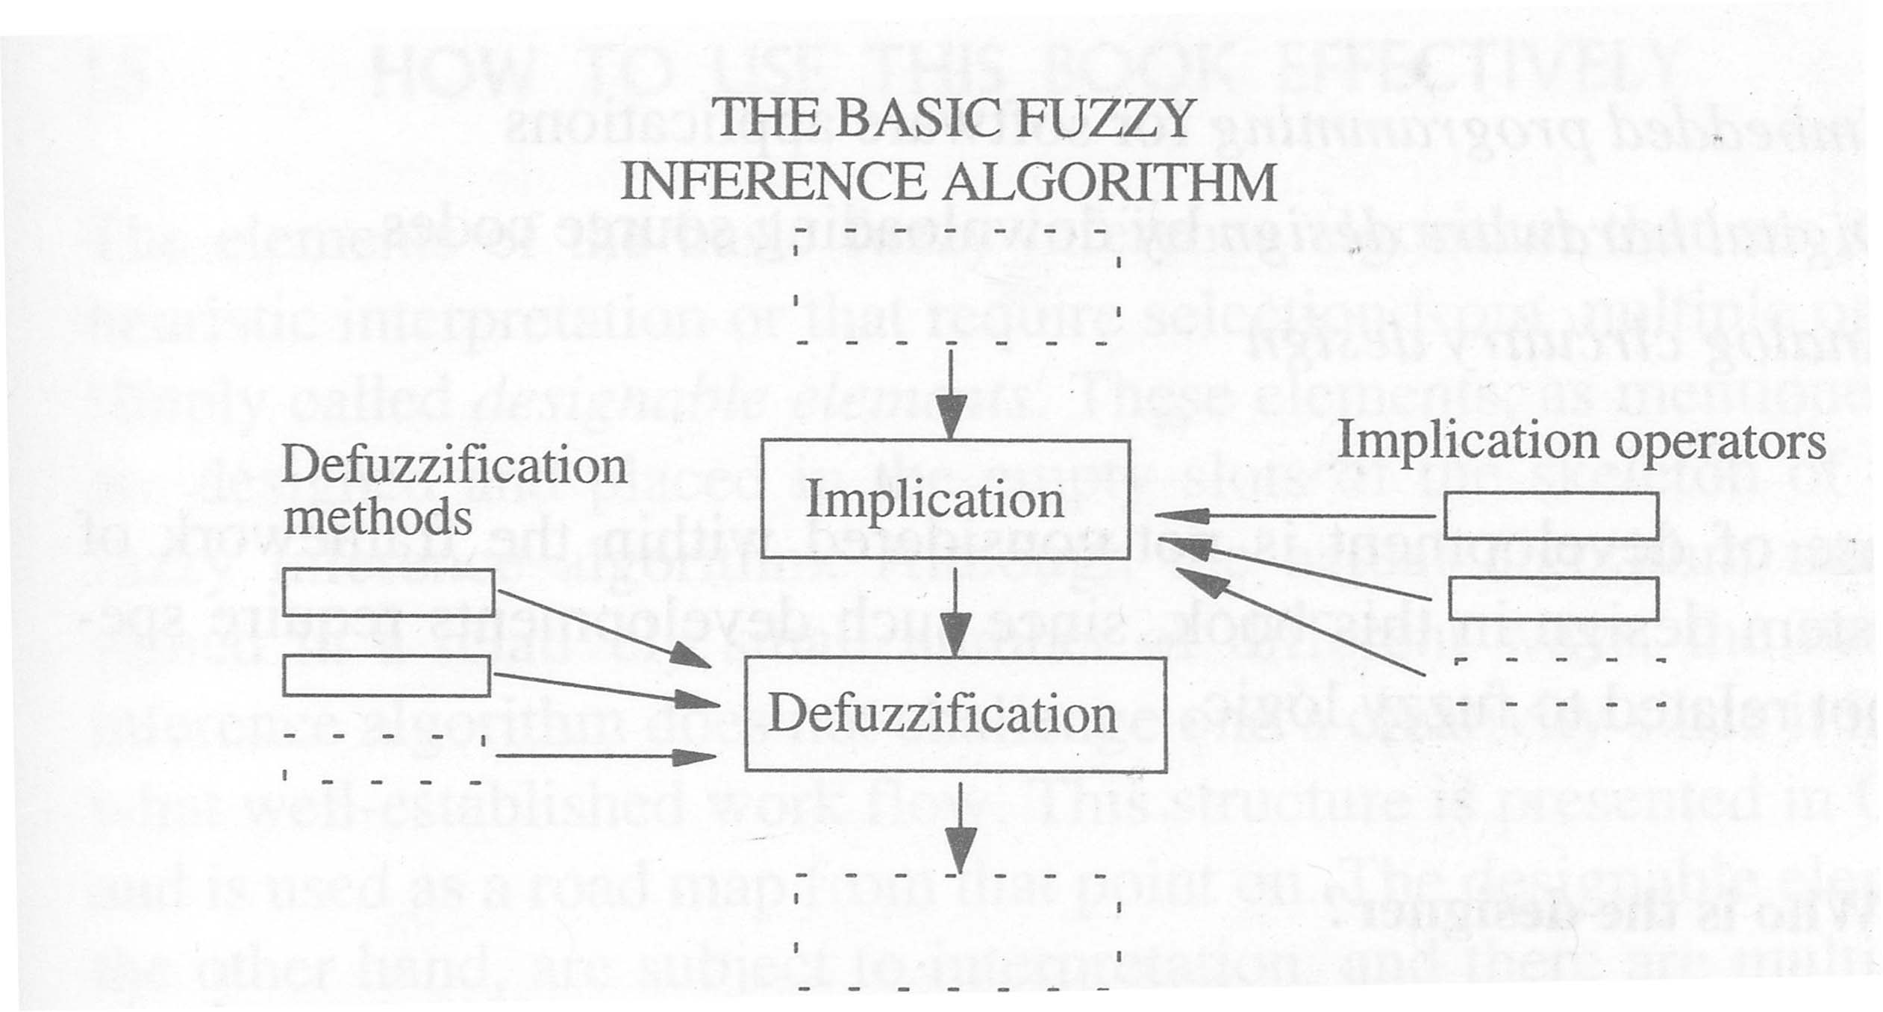
Fuzzy system design

Slide 11
Simulation and testing
Simulation is defined as the process of creating a model of an existing or proposed system in order to identify and understand those factors which control the system and/or to predict (forecast) the future behavior of the system.

Slide 12
How are fuzzy systems implemented?
The design involves special purpose software products that include design tools.
Once a development is finalized, the fuzzy algorithm is converted into a computer program.
Then the program is imported into the application environment.
If this environment is a computer program or a software package, then fuzzy algorithms are embedded.
If this environment is digital hardware such as VLSI chips, then fuzzy algorithms are downloaded (or burned) on digital platforms.
If the hardware is an analog device, then the fuzzy algorithm is implemented by circuitry design.

Slide 13
How are fuzzy systems implemented
There are three forms of fuzzy system implementation:
Embedded programming for software applications
Digital hardware design by downloading source codes
Analog circuitry design

Slide 14
Who is the designer?
Three different specialties are required to complete a working fuzzy system
An expert who knows the conventional non-fuzzy solution or method
A fuzzy logic specialist who can perform the design steps
A software/hardware specialist who can implement the design

Slide 15
What are the design tools?
Fuzzy system design requires a computer-aided design environment in which some of the tedious tasks are automated or already designed.

Slide 16
Operation of Fuzzy System
Crisp Input
Fuzzification
Input Membership Functions
Fuzzy Input
Rule Evaluation
Rules / Inferences
Fuzzy Output
Defuzzification
Output Membership Functions
Crisp Output

Slide 17
Building Fuzzy Systems
Fuzzification
Inference
Composition
Defuzzification

Slide 18
Fuzzification
Establishes the fact base of the fuzzy system.
It identifies the input and output of the system, defines appropriate IF THEN rules, and uses raw data to derive a membership function.
Consider an air conditioning system that determine the best circulation level by sampling temperature and moisture levels. The inputs are the current temperature and moisture level. The fuzzy system outputs the best air circulation level: “none”, “low”, or “high”. The following fuzzy rules are used:
1. If the room is hot, circulate the air a lot.
2. If the room is cool, do not circulate the air.
3. If the room is cool and moist, circulate the air slightly.
A knowledge engineer determines membership functions that map temperatures to fuzzy values and map moisture measurements to fuzzy values.

Slide 19
Inference
Evaluates all rules and determines their truth values.
If an input does not precisely correspond to an IF THEN rule, partial matching of the input data is used to interpolate an answer.
Continuing the example, suppose that the system has measured temperature and moisture levels and mapped them to the fuzzy values of .7 and .1 respectively.
The system now infers the truth of each fuzzy rule. To do this a simple method called MAX-MIN is used.
This method sets the fuzzy value of the THEN clause to the fuzzy value of the IF clause.
Thus, the method infers fuzzy values of 0.7, 0.1, and 0.1 for rules 1, 2, and 3 respectively.

Slide 20
Composition
Combines all fuzzy conclusions obtained by inference into a single conclusion. Since different fuzzy rules might have different conclusions, consider all rules.
Continuing the example, each inference suggests a different action
rule 1 suggests a "high" circulation level
rule 2 suggests turning off air circulation
rule 3 suggests a "low" circulation level.
A simple MAX-MIN method of selection is used where the maximum fuzzy value of the inferences is used as the final conclusion. So, composition selects a fuzzy value of 0.7 since this was the highest fuzzy value associated with the inference conclusions.

Slide 21
Defuzzification
Convert the fuzzy value obtained from composition into a “crisp” value.
This process is often complex since the fuzzy set might not translate directly into a crisp value.
Defuzzification is necessary, since controllers of physical systems require discrete signals.
Continuing the example, composition outputs a fuzzy value of 0.7. This imprecise value is not directly useful since the air circulation levels are “none”, “low”, and “high”.
The defuzzification process converts the fuzzy output of 0.7 into one of the air circulation levels. In this case it is clear that a fuzzy output of 0.7 indicates that the circulation should be set to “high”.

Slide 22
Fuzzy Control
Let us assume that this fuzzy logic controller (FLC) control a hot water heater.
The hot water heater has a knob, heatknob (0-10) on it to control the heating element power, the higher the value, the hotter it gets, with a value of 0 indicating the heating element is turned off.
There are two sensors in the hot water heater, one to tell you the temperature of the water(tempsense) , which various from 0 to 125 C, and the other to tell you the level of the water in the tank(levelsense), which various from 0=empty to 10=full.
Assume that there is an automatic flow control that determines how much cold water flows into the tank from the main water supply; when ever the level of the water gets below 40, the flow control turns on, and turns off when the level of the water gets above 95.

Slide 23
Step 1: defining inputs and outputs for the FLC
The range of values that inputs and outputs may take is called the universe of discourse.
We need to define the universe of discourse for all of the inputs and outputs of the FLC, which are all crisp values
Name input/output minimum value maximum value
LevelSense I 0 10
HeatKnob O 0 10
TempSense I 0 125

Slide 24
Step 2: Fuzzify the Inputs
The inputs to the FLC are the LevelSense and the TempSense.
Fuzzy variables ranges for LevelSense
Crisp Input Range | Fuzzy Variables
0-2 | Xsmall
1.5-4 | Small
3-7 | Medium
6-8.5 | Large
7.5-10 | XLarge

Slide 25
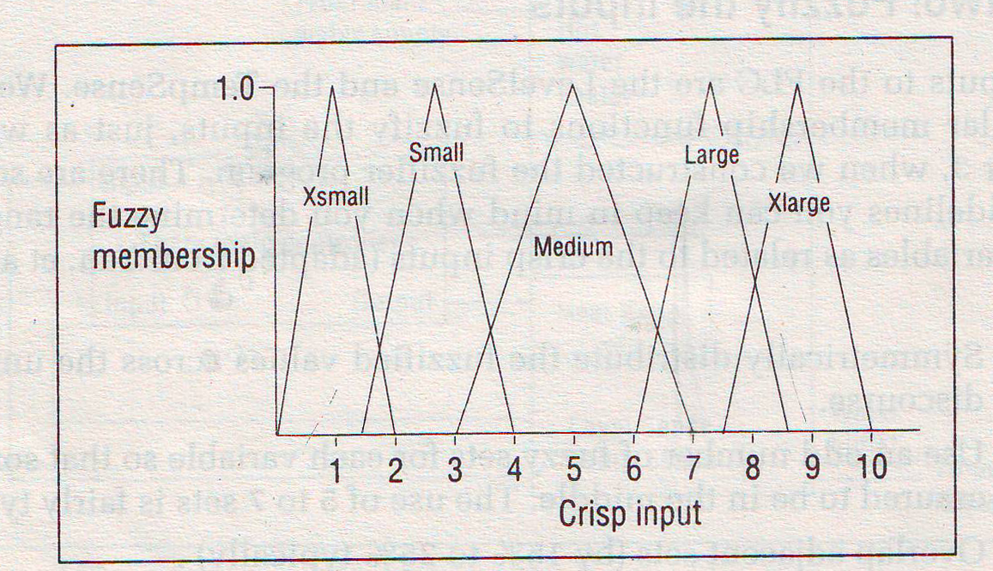
Fuzzy Membership functions for LevelSense

Slide 26
Step 2: Fuzzify the Inputs
Fuzzy variables ranges for TempSense
Crisp Input Range | Fuzzy Variables
0-20 | Xsmall
10-35 | Small
30-75 | Medium
60-95 | Large
85-125 | XLarge

Slide 27
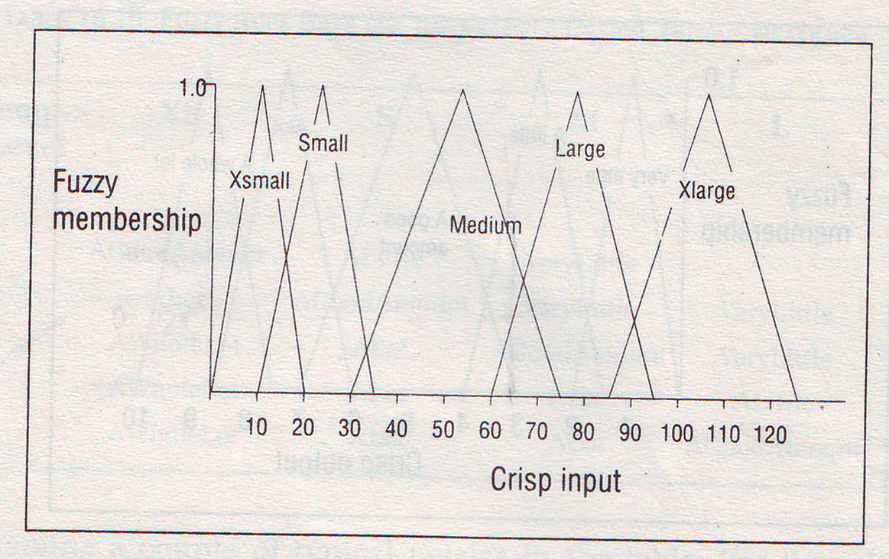
Fuzzy Membership functions for TempSense

Slide 28
Step 3: Set up Fuzzy Membership Functions for the outputs
We have just one output, which is the HeatKnob.
Crisp Output Range | Fuzzy Variables
0-2 | VeryLittle
1.5-4 | Alittle
3-7 | AGoodAmount
6-8.5 | A lot
7.5-10 | AWholeLot

Slide 29
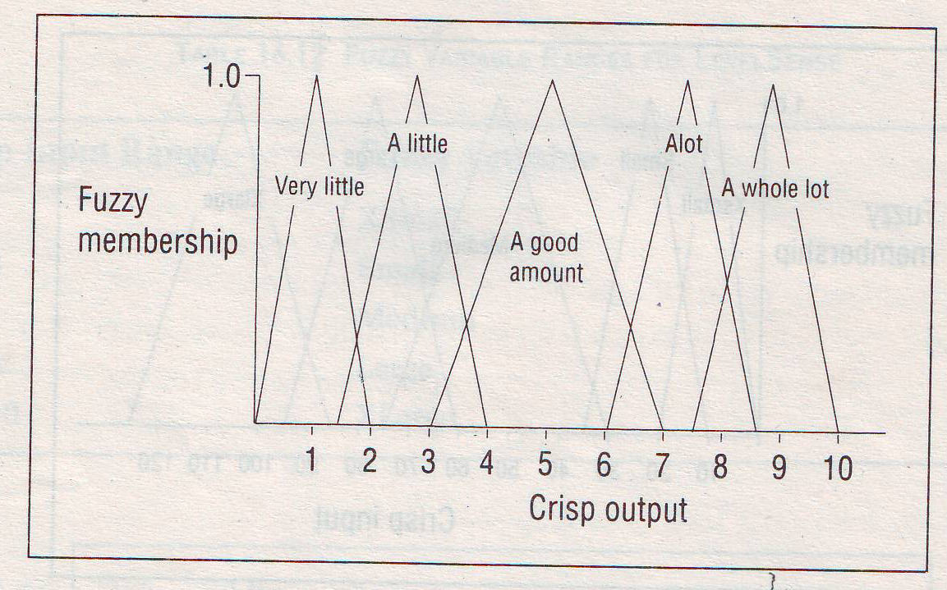
Fuzzy Membership functions for HeatKnob

Slide 30
Step 4: Create a Fuzzy Rule Base
Now we have the inputs and the output defined in terms of fuzzy variables.
Now we need to specify what actions to take under what conditions.
That is we need to construct a set of rules that describe the operation of the FLC.
These rules take the form of IF-THEN rules and can be obtained from a human expert.

Slide 31
Step 4: Create a Fuzzy Rule Base
SenseTemp | XS | S | M | L | XL
SenseLevel
XS | AGoodAmount | ALittle | VeryLittle
S | ALot | AGoodAmount | VeryLittle | VeryLittle
M | AWholeLot | ALot | AGoodAmount | VeryLittle
L | AWholeLot | ALot | ALot | ALittle
XL | AWholeLot | ALot | ALot | AGoodAmount

Slide 32
Creating IF-THEN Rules
We can now translate the table entries into IF-THEN rules.
IF SenseTemp IS XSmall AND SenseLevel IS Xsmall THEN SET HeatKnob TO AGoodAmount
IF SenseTemp IS XSmall AND SenseLevel IS Xsmall THEN SET HeatKnob TO ALot
IF SenseTemp IS XSmall AND SenseLevel IS Medium THEN SET HeatKnob TO AWholeLot
IF SenseTemp IS XSmall AND SenseLevel IS Large THEN SET HeatKnob TO AWholeLot
IF SenseTemp IS XSmall AND SenseLevel IS XLarge THEN SET HeatKnob TO AWholeLot

Slide 33
Creating IF-THEN Rules
IF SenseTemp IS Small AND SenseLevel IS Xsmall THEN SET HeatKnob TO ALittle
IF SenseTemp IS Small AND SenseLevel IS Small THEN SET HeatKnob TO AGoodAmount
IF SenseTemp IS Small AND SenseLevel IS Medium THEN SET HeatKnob TO ALot
IF SenseTemp IS Small AND SenseLevel IS Large THEN SET HeatKnob TO ALot
IF SenseTemp IS Small AND SenseLevel IS XLarge THEN SET HeatKnob TO ALot
IF SenseTemp IS Medium AND SenseLevel IS XSmall THEN SET HeatKnob TO VeryLittle
IF SenseTemp IS Medium AND SenseLevel IS small THEN SET HeatKnob TO VeryLittle

Slide 34
Creating IF-THEN Rules
IF SenseTemp IS Medium AND SenseLevel IS Medium THEN SET HeatKnob TO AGoodAmount
IF SenseTemp IS Medium AND SenseLevel IS Large THEN SET HeatKnob TO ALot
IF SenseTemp IS Medium AND SenseLevel IS XLarge THEN SET HeatKnob TO ALot
IF SenseTemp IS Large AND SenseLevel IS small THEN SET HeatKnob TO VeryLittle
IF SenseTemp IS Large AND SenseLevel IS Medium THEN SET HeatKnob TO VeryLittle
IF SenseTemp IS Large AND SenseLevel IS Large THEN SET HeatKnob TO ALittle
IF SenseTemp IS Large AND SenseLevel IS XLarge THEN SET HeatKnob TO AGoodAmount

Slide 35
Step 5: Defuzzify the Outputs
In order to control the HeatKnob, we need to obtain a crisp dial setting.
So far, we have several of the IF–THEN rules of the fuzzy rule base firing at once, because the inputs have been fuzzified.
How do we arrive at a single crisp output number ?
There are actually several different strategies for this; we will consider two of the most common, the center of area (COA) or centroid method, and the fuzzy Or method.
The easiest way to understand the process is with an example.

Slide 36
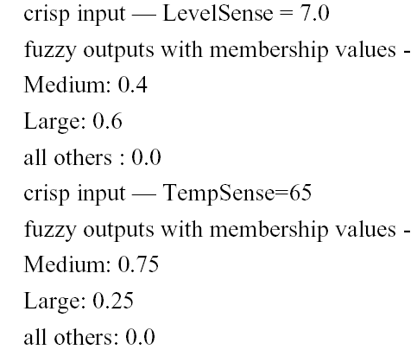
Example
Assume that at a particular point in time, LevelSense = 7.0 and TempSense = 65.
These are the crisp inputs directly from the sensors. With fuzzification , assume that you get the following fuzzy memberships:

Slide 37
Example
This results in four rules firing:
1. TempSense = Medium (0.75) AND LevelSense = Medium (0.4)
2. TempSense = Large (0.25) AND LevelSense = Medium (0.4)
3. TempSense = Medium (0.75) AND LevelSense = Large (0.6)
4. TempSense = Large (0.25) AND LevelSense = Large (0.6)
First you must determine, for each of the AND clauses in the IF–THEN rules, what the output should be.
This is done by the conjunction or minimum operator. So for each of these rules you have the following firing strengths:

Slide 38
Example
1. (0.75) ^ (0.4) = 0.4
2. (0.25) ^ (0.4) = 0.25
3. (0.75) ^ (0.6) = 0.6
4. (0.25) ^ (0.6) = 0.25
By using the fuzzy rule base and the strengths assigned previously, we find the rules recommend the following output values (with strengths) for HeatKnob:
1. AGoodAmount (0.4)
2. VeryLittle (0.25)
3. ALot (0.6)
4. ALittle (0.25)

Slide 39
Example
Now we must combine the recommendations to arrive at a single crisp value.
Here we use a disjunction or maximum operator to combine the values.
We obtain the following:
(0.4) ∨ (0.25) ∨ (0.6) ∨(0.25) = 0.6
The crisp output value for HeatKnob would then be this membership value multiplied by the range of the output variable, or (0.6) (10-0) = 6.0.

Slide 40
Advantages of Fuzzy Logic Controllers
Relates input to output in linguistic terms, easily understood
Allows for rapid prototyping because the system designer doesn’t need to know everything about the system before starting
Cheaper because they are easier to design
Increased robustness
Simplify knowledge acquisition and representation
A few rules encompass great complexity
Can achieve less overshoot and oscillation
Can achieve steady state in a shorter time interval

Slide 41
Disadvantages of Fuzzy Logic Controllers
Hard to develop a model from a fuzzy system
Require more fine tuning and simulation before operational
Have a stigma associated with the word fuzzy; engineers and most other people are used to crispness and shy away from fuzzy control and fuzzy decision making

Slide 42
Linguistic Variables

Slide 43
Linguistic Variables
A variable is a symbolic name given to some known or unknown quantity or information.
A numerical variables takes numerical values: Age = 65
A linguistic variables takes linguistic values: Age is old
A linguistic values is a fuzzy set.
All linguistic values form a term set:
T(age) = {young, not young, very young, ...
middle aged, not middle aged, ...
old, not old, very old, more or less old, ...
not very young and not very old, ...}

Slide 44
Linguistic Variables
Linguistic variable is “a variable whose values are words or sentences in a natural or artificial language”.
For example, the values of the fuzzy variable height could be tall, very tall, very very tall, somewhat tall, not very tall, tall but not very tall, quite tall, more or less tall.
Each linguistic variable may be assigned one or more linguistic values, which are in turn connected to a numeric value through the mechanism of membership functions.

Slide 45
Linguistic Variables
In fuzzy expert systems, linguistic variables are used in fuzzy rules. For example:
IF wind is strong
THEN sailing is good
IF project_duration is long
THEN completion_risk is high
IF speed is slow
THEN stopping_distance is short

Slide 46
Example
if temperature is cold and oil is cheap then heating is high

Slide 47
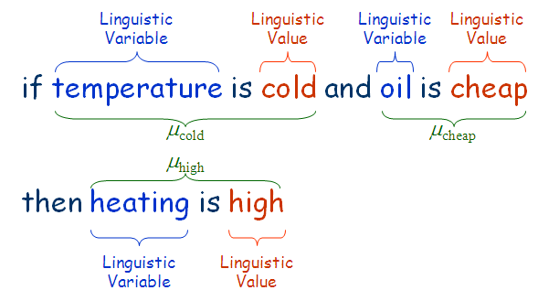
Example

Slide 48
Definition [Zadeh 1973]
A linguistic variable is characterized by a quintuple
Name
Term Set
Universe
Syntactic Rule
Semantic Rule

Slide 49
Example
A linguistic variable is characterized by a quintuple
age
Example semantic rule:
[0, 100]

Slide 50
Example
Linguistic Variable : temperature
Linguistics Terms (Fuzzy Sets) : {cold, warm, hot}
μ(x)
μ_{cold}
μ_{warm}
μ_{hot}
1
60
x
20

Slide 51
Linguistic Variables and Hedges
The range of possible values of a linguistic variable represents the universe of discourse of that variable. For example, the universe of discourse of the linguistic variable speed might have the range between 0 and 220 km/h and may include such fuzzy subsets as very slow, slow, medium, fast, and very fast.
A linguistic variable carries with it the concept of fuzzy set qualifiers, called hedges.
Hedges are terms that modify the shape of fuzzy sets. They include adverbs such as very, somewhat, quite, more or less and slightly.

Slide 52
Operations on Linguistic Values
Concentration:
Dilation:
intensif.m

Slide 53
Solve
Let fuzzy set be A={(1,0),(2,0.1),(3,0.2),(4,0.5),(5,0.3),(6,0.1),(7,0.0),(8,0.0),(9,0.0),(10,1)}
CON(A)=(2,0.01),(3,0.04),(4,0.25),(5,0.09),(6,0.01),(10,1)
DIL(A)= (2,0.31),(3,0.44),(4,0.70),(5,0.54),(6,0.31),(10,1)

Slide 54
What is a fuzzy rule?
Fuzzy rules are useful for modeling human thinking, perception and judgment.
A fuzzy rule can be defined as a conditional statement in the form:
IF x is A THEN y is B
where x and y are linguistic variables; and A and B are linguistic values determined by fuzzy sets on the universe of discourses X and Y, respectively.
“x is A” is called antecedent and “y is B” is called consequent.

Slide 55
What is the difference between classical and fuzzy rules?
A classical IF-THEN rule uses binary logic, for example,
Rule: 1 Rule: 2
IF speed is > 100 IF speed is < 40
THEN stopping_distance is long THEN stopping_distance is short
The variable speed can have any numerical value between 0 and 220 km/h, but the linguistic variable stopping_distance can take either value long or short.
In other words, classical rules are expressed in the black-and-white language of Boolean logic.

Slide 56
We can also represent the stopping distance rules in a fuzzy form:
Rule: 1 Rule: 2
IF speed is fast IF speed is slow
THEN stopping_distance is long THEN stopping_distance is short
In fuzzy rules, the linguistic variable speed also has the range (the universe of discourse) between 0 and 220 km/h, but this range includes fuzzy sets, such as slow, medium and fast.
The universe of discourse of the linguistic variable stopping distance can be between 0 and 300 m and may include such fuzzy sets as short, medium and long.

Slide 57
Firing Fuzzy Rules
These fuzzy sets provide the basis for a weight estimation model. The model is based on a relationship between a man’s height and his weight:
IF height is tall THEN weight is heavy

Slide 58
Firing Fuzzy Rules
A fuzzy rule can have multiple antecedents, for example:
IF project_duration is long AND project_staffing is large AND
project_funding is inadequate
THEN risk is high
IF service is excellent OR food is delicious
THEN tip is generous
The consequent of a fuzzy rule can also include multiple parts, for instance:
IF temperature is hot
THEN hot_water is reduced;
cold_water is increased

Slide 59
Fuzzy Proposition

Slide 60
Proposition
Propositions are elementary atomic sentences(we shall also use the term formulas or well-formed formulas in place of sentences).
Propositions may be either true or false but may take on no other value.
There are two kinds of proposition
Simple
compound
Some examples of simple propositions are
It is raining.
My car is painted silver.
John and sue have five children.
Snow is white.
People live on the moon.

Slide 61
Proposition continued….
Compound propositions are formed from atomic formulas using the logical connectives not or if ………then, and if and only if.
For example, the following are compound formulas.
It is raining and the wind is blowing.
The moon is made of green cheese or it is not.
If you study hard you will be rewarded.
The sum of 10 and 20 is not 50.

Slide 62
Logic
One of the prime activity of human intelligence is reasoning.
The activity of reasoning involves construction, organization and manipulation of statements to arrive at new conclusions.
Logic is the study of the methods and principles of reasoning in all its possible forms.

Slide 63
Propositional logic
Propositional logic is a representational language that makes the assumption that the world can be represented solely in terms of propositions that are true or false.
One of the main concerns of propositional logic is the study of rules by which new logic variables can be produced as functions of some given logic variables.

Slide 64
Fuzzy Proposition
Fuzzy Proposition – Propositions that include fuzzy predicates. For example,
It will be sunny today.
Dow Jones is closed higher yesterday.
Canonical Form – (Unconditional fuzzy proposition)
x is A
A (a fuzzy set) is a fuzzy predicate called the fuzzy variable or the linguistic variable. The values of a linguistic variable are words or sentences in a natural or synthetic language.

Slide 65
Fuzzy Proposition
Note that a linguistic variable is a fuzzy (sub)set defined on a Universe of discourse. For example,
Janet is young
implies the AGE of Janet is Young. Here, Young is a fuzzy set defined on the axis "Age".
Other fuzzy sets may be defined on the same universe include "Old", "Mid-age", etc.
Age is a property of "Janet", and Young is a specific subset of "Age".

Slide 66
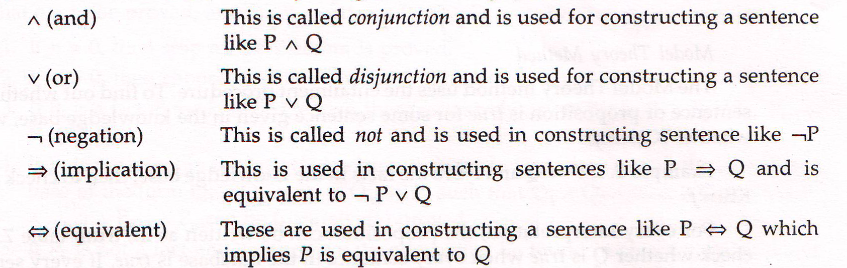
Syntax for Propositional logic
Propositional logic consists of propositional symbols such as P,Q,R,S and logic connectives given below.

Slide 67

Example
Write the syntax for propositional logic
If the road is closed, then the traffic is blocked.
“the road is closed” is represented by a proposition, P .
“then the traffic is blocked” is represented by a proposition, Q .
The sentence is represented as

Slide 68
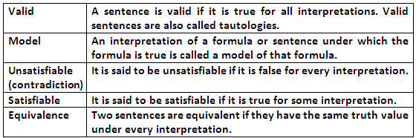
Semantics for Propositional logic
The semantics or meaning of a sentence is just the value true or false. The terms used for semantics of a language are given below.

Slide 69
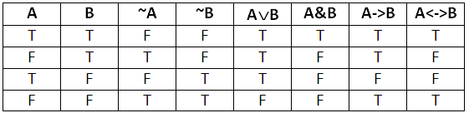
Truth tables for logical connectives

Slide 70
EXAMPLE
Let A be a proposition- the machine is defective
and B be a proposition- the production is less
The implication is written as,
If the machine is defective THEN production is less.
Now we analyze all the combination to find whether the truth table is correct or not.

Slide 71
Solution
In the first condition, we have that if A is true and B is also true then A->B is also true, i.e if machine is defective then production is less which is true.
Secondly, if A is false and B is also true then A->B is true, i.e if machine is not defective then production is less. Of course it may be true because production can be less because of many reasons.
If A is true and B is false then A->B is false, i.e if machine is defective then production is not less. Of course it is false, as production will directly get affected by machine performance.
If A is false and B is also false then A->B is true, i.e if machine is not defective then production is not less. No doubt it is true.

Slide 72
Show that

Slide 73
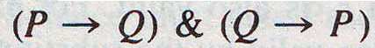
Show that
P <-> Q is equivalent to

Slide 74
Show that
P -> Q is equivalent to ~P ∨ (P ∧Q)

Slide 75
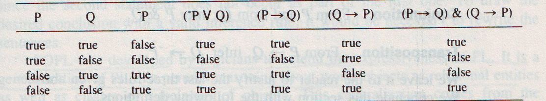
Truth table for equivalent sentences

Slide 76
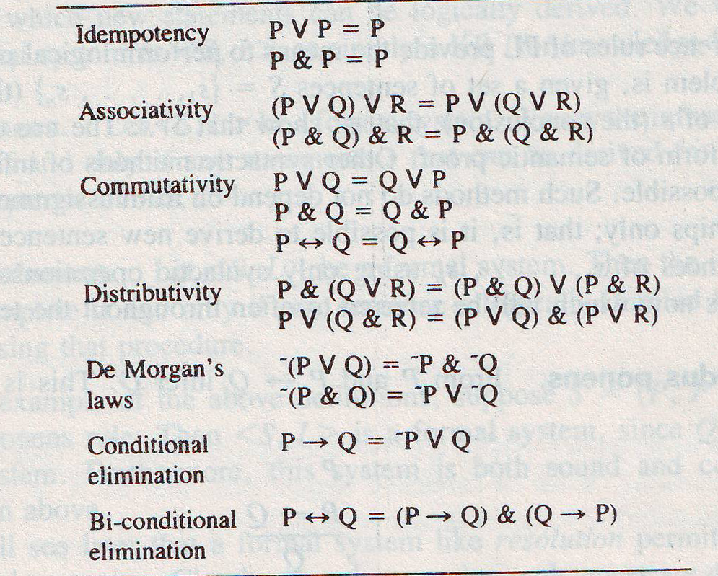
Some Equivalence Laws

Slide 77
Question 1
Determine whether each of the following sentences is (a) Satisfiable (b) Contradictory and (c) Valid.
S1: (P & Q) ∨ ~(P ∨ Q)
S2: (P ∨ Q)-> (P & Q)
S3: (P & Q) -> (P ∨ ~Q)
S4: (P ∨ Q) & (P ∨ ~Q) ∨ P
S5: P -> Q->~P
S6: P ∨ Q & ~P ∨ ~Q &P

Slide 78
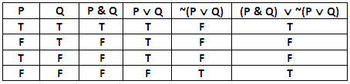
S1
S1: (P & Q) ∨ ~(P ∨ Q) satisfiable

Slide 79
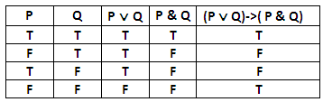
S2
S2: (P ∨ Q)-> (P & Q) satisfiable

Slide 80
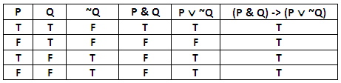
S3
S3: (P & Q) -> (P ∨ ~Q) valid

Slide 81
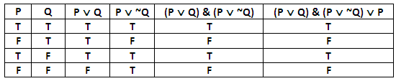
S4
S4: (P ∨ Q) & (P ∨ ~Q) ∨ P satisfiable

Slide 82
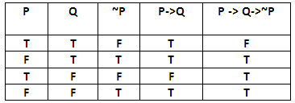
S5
S5: P -> Q->~P satisfiable

Slide 83
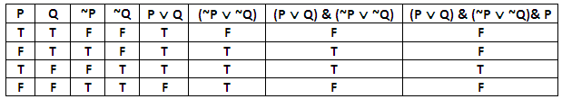
S6
S6: P ∨ Q & ~P ∨ ~Q &P satisfiable

Slide 84
Question 2
Construct the truth table
(P <-> (Q ∧ R)) -> (~R-> ~Q)

Slide 85
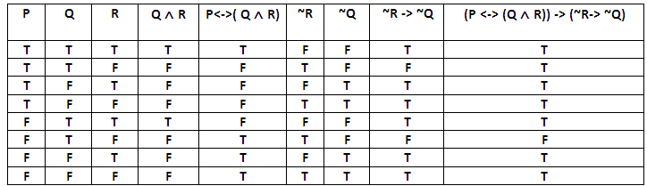
Solution 2

Slide 86
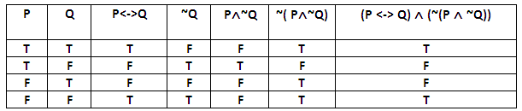
Question 3
Construct the truth table
(P <-> Q) ∧ (~(P ∧ ~Q))

Slide 87
Types of fuzzy Propositions
Unconditional and unqualified propositions
Unconditional and qualified propositions
Conditional and unqualified propositions
Conditional and qualified propositions

Slide 88
Unconditional and unqualified propositions
The canonical form of fuzzy proposition is express by the sentence
P: V is F
Where,
V : is a variable that takes values v from some universal set V.
F: is a fuzzy set on V that represents a fuzzy predicate, such as tall, low, normal and so on.
Example:
P: temperature (V ) is high (F).

Slide 89
Unconditional and qualified propositions
Proposition of this type can be characterized by either the canonical form
P: V is F is S
Or the canonical form
p: Pro{V is F} is P
Example:
Tina is young is very true.

Slide 90
Conditional and unqualified propositions
Proposition of this type can be expressed by the canonical form
p: if X is A, then Y is B
Where X, Y are variables whose values are in sets X, Y, respectively, and A, B are fuzzy sets on X, Y, respectively.
Example:
If the machine is defective THEN production is less.

Slide 91
Conditional and qualified propositions
Proposition of this type can be characterized by either the canonical form
p: if X is A, then Y is B is S
Or the canonical form
p: Pro{X is A|Y is B} is P
Where Pro{X is A|Y is B} is a conditional probability.
Example:
If the machine is defective THEN production is less is very true.

Slide 92
Compositional rules of inference

Slide 93
Compositional rules of inference
The inference rules of PL provide the means to perform logical proofs or deductions.
Rules are
Modus ponens
Modus tollens
Chain rule
Substitution
Simplification
Conjunction
Transposition

Slide 94
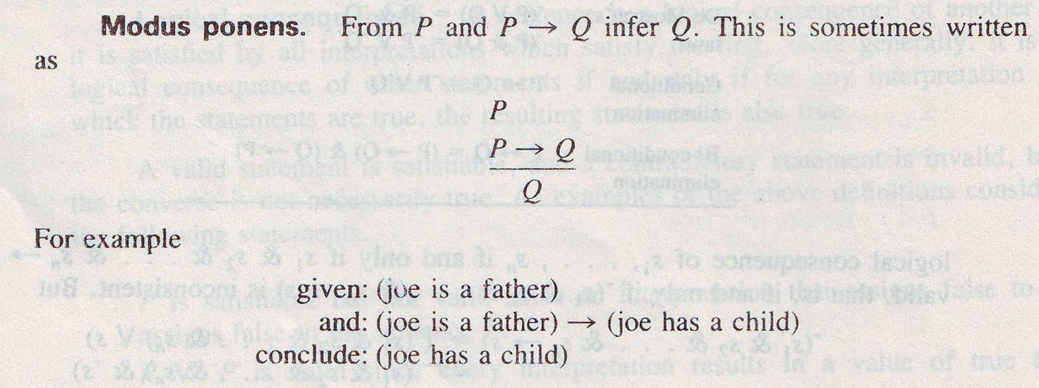
Inference Rules cont………

Slide 95
Inference Rules cont………
Modus tollens
α → β ¬β ¬α
Example:
Given: The machine is defective ->the production is less
And: the production is not less
Conclude: The machine is not defective

Slide 96
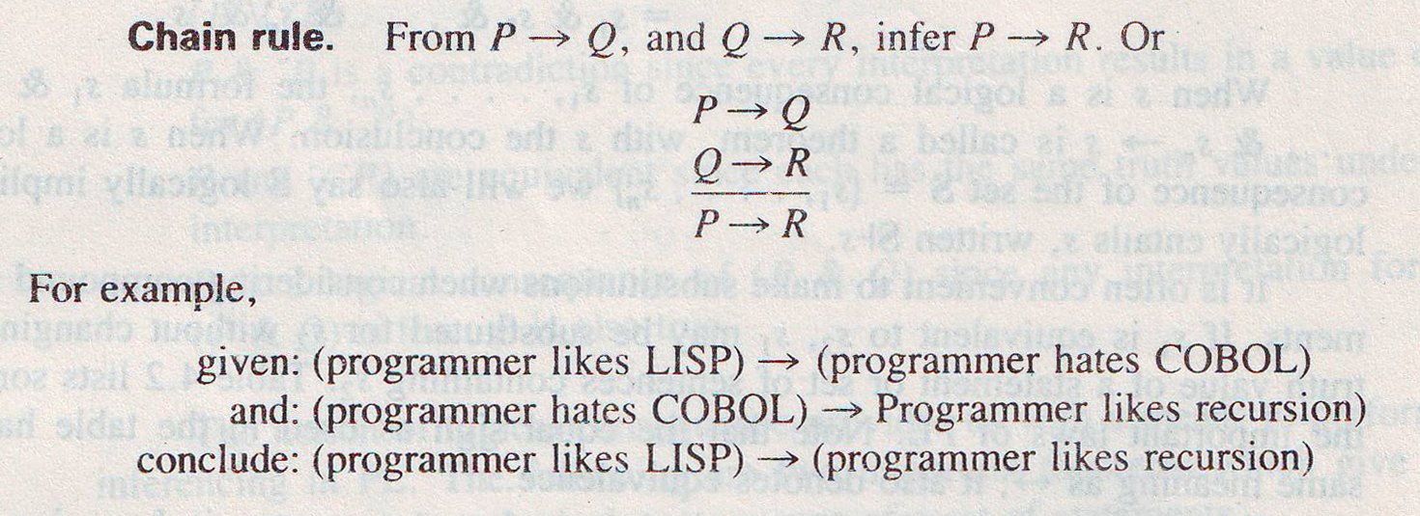
Inference Rules cont………

Slide 97
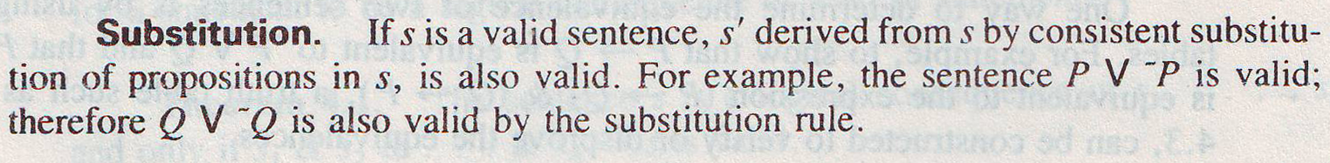
Inference Rules cont………

Slide 98
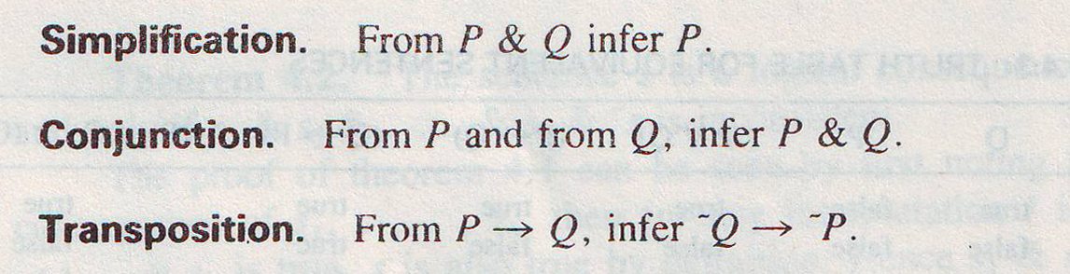
Inference Rules cont………

Slide 99
Methods of decompositions

Slide 100
Decomposition of compound rules
A linguistic statement expressed by a human might involve compound rule structures.
As an example, consider a rule base for a simple home temperature control problem, which might contain the following rules.

Slide 101
Example
IF it is raining hard
THEN close the window.
IF the room temperature is very hot,
THEN
IF the heat is on
THEN turn the heat lower
ELSE
IF (the window is closed) AND (the air conditioner is off)
THEN (turn on the air conditioner)
AND (it is not raining hard)
THEN open the window
ELSE
IF (the window is closed) AND (the air conditioner is on)
THEN open the window; etc.

Slide 102
Continued…..
By using the basic properties and operations defined for fuzzy sets, any compound rule structure may be decomposed and reduced to a number of simple canonical rules.
These rules are based on natural language representations and models, which are themselves based on fuzzy sets and fuzzy logic.

Slide 103
Continued…..
The following illustrate a number of the most common techniques for decomposition of compound linguistic rules into simple canonical forms:
Multiple conjunctive antecedents
Multiple disjunctive antecedents
Conditional statements with ELSE and UNLESS
Nested IF-THEN rules

Slide 104
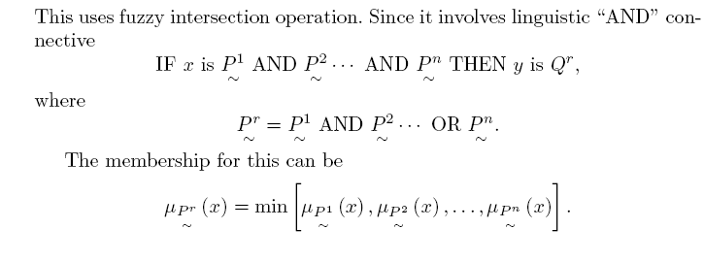
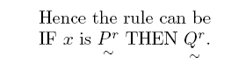
Multiple conjunctive antecedents

Slide 105
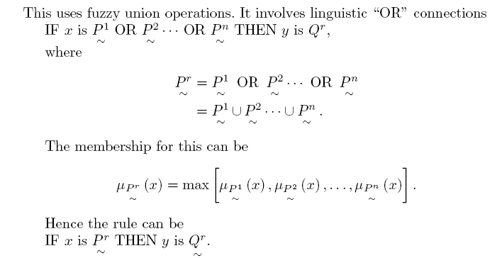
Multiple disjunctive antecedents

Slide 106
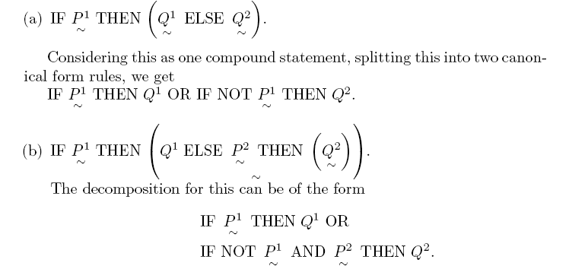
Conditional statements with ELSE

Slide 107
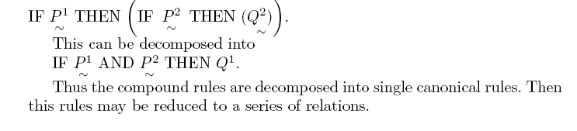
Nested IF-THEN rules

Slide 108
Defuzzification

Slide 109
Defuzzification
In many situations, for a system whose output is fuzzy, it is easier to take a crisp decision if the output is represented as a single scalar quantity.
The conversion of a fuzzy set to single crisp value is called defuzzification.
It is a reverse process of fuzzification.

Slide 110
Defuzzification techniques
Maximum Defuzzification Technique
Centroid Defuzzification Technique
Weighted Average Defuzzification Technique
Mean-Max Membership
Centre of sum
Centre of singleton Method

Slide 111
Maximum Defuzzification Technique
This method gives the output with the highest membership function.
This defuzzification technique is very fast but is only accurate for peaked output.
This technique is given by algebraic expression as
for all x ε X

Slide 112
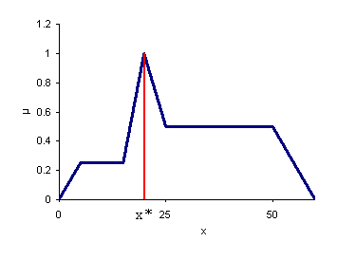
Maximum Defuzzification Technique
where x* is the defuzzified value.

Slide 113
Centroid Defuzzification Technique
This method is also known as Center Of Gravity (COG) or Center Of Area (COA) defuzzification.
This technique was developed by Sugeno in 1985.
This is the most commonly used technique and is very accurate.
The centroid defuzzification technique can be expressed as

Slide 114
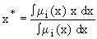
Centroid Defuzzification Technique
where x* is the defuzzified output, μ_{i}(x) is the aggregated membership function and x is the output variable.
The only disadvantage of this method is that it is computationally difficult for complex membership functions.

Slide 115
Centroid Defuzzification Technique
μ
1
X* X

Slide 116
Centroid Defuzzification Technique

Slide 117
Weighted Average Defuzzification
In this method the output is obtained by the weighted average of the each output of the set of rules stored in the knowledge base of the system.
The weighted average defuzzification technique can be expressed as

Slide 118
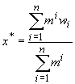
Weighted Average Defuzzification
where x* is the defuzzified output, m^{i} is the membership of the output of each rule, and w_{i} is the weight associated with each rule. This method is computationally faster and easier and gives fairly accurate result

Slide 119
Weighted Average Defuzzification
μ
.9
.5
0 a b z

Slide 120
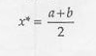
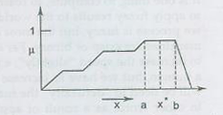
Mean-Max Membership
This method is closely related to the first method, except that the location of maximum membership can be non-unique.
It is given by expression:

Slide 121
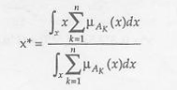
Centre of sum
This process involves the algebraic sum of individual output fuzzy sets, instead of their union.
The difuzzified value x* is given by:

Slide 122
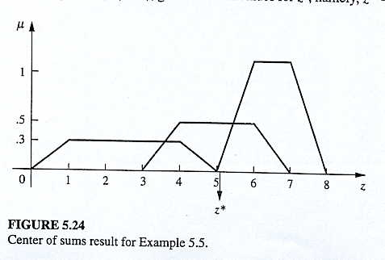
Centre of sum

Slide 123
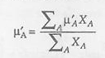
Centre of singleton Method
Defuzzification can be strongly simplified if the membership functions μ_{A}(x) of the conclusions are singly defuzzified for each rule such that each function is reduced to a singleton that has the position of the individual membership function’s centre of gravity.
The centre of singleton is calculated by using the degree of relevance as follows:

Slide 124
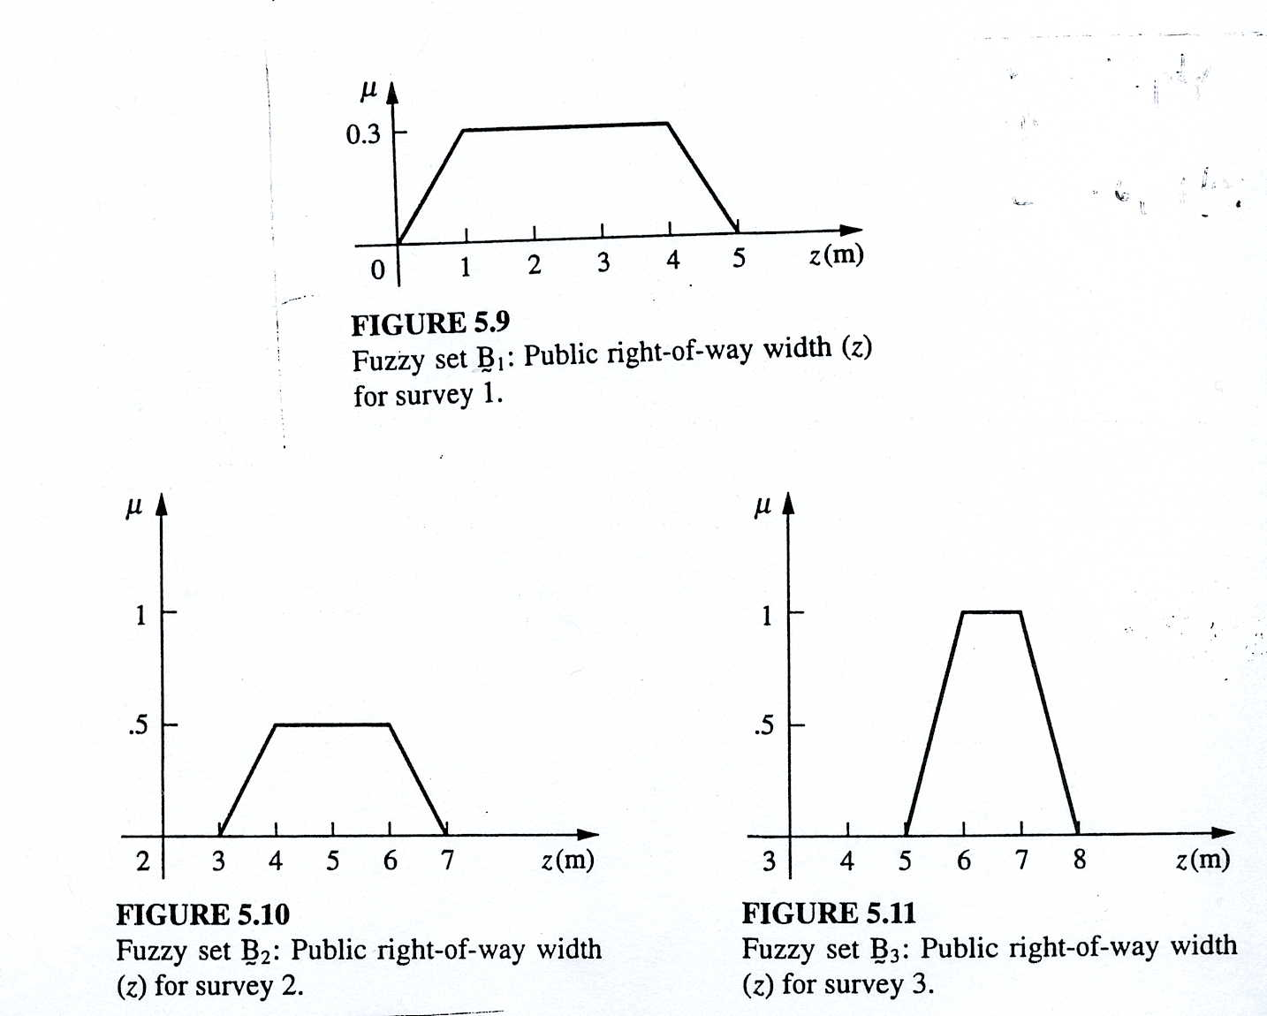
Example
The data for 3 fuzzy sets is shown in figure. Difuzzify the data using weighted average method and mean-max membership method.

Slide 125
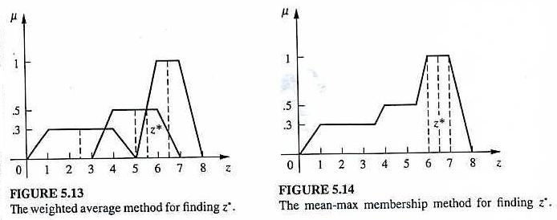
Solution
Weighted-Average Method:
Mean-Max Method:

Slide 126
Centre of sum

Slide 127
Fuzzy inference system
The advantage of a fuzzy set approach is that it can usefully describe imprecise, incomplete or vague information.
However, being able to describe such information is of little practical use unless we can infer with it.
The accepted method of the application of fuzzy sets is analogous to, but different from, the way a conventional knowledge base system is organized.
Assuming that there is a particular problem that cannot be tackled by conventional methods such as by developing a mathematical model, after some process, the ‘base’ fuzzy sets that describe the problem are determined.
After that the IF-THEN rules are thus determined.
These rules then have to be combined in some way referred to as rule composition.
Finally conclusions have to be drawn.

Slide 128
Fuzzy inference system cont……….
Thus it is a process of formulating the mapping from a given input to an output using fuzzy logic.
Fuzzy inference system have been successfully applied in fields such as automatic control, data classification, decision analysis, expert systems.
Because of its multidisciplinary nature, fuzzy inference systems are associated with a number of names, such as fuzzy-rule-based systems, fuzzy expert systems, fuzzy modeling, fuzzy associative memory, fuzzy logic controllers, and simply fuzzy systems.

Slide 129
Fuzzy inference system cont……….
Fuzzy inference system consists of five functional blocks
A rule base containing a number of fuzzy if-then rules;
A database which defines the membership functions of the fuzzy sets used in the fuzzy rules,
A decision making unit which perform inference operations on the rules
A fuzzification interface which transforms the crisp inputs into degree of match with linguistics values
a defuzzification interface which transform the fuzzy results of the interface into a crisp output.

Slide 130
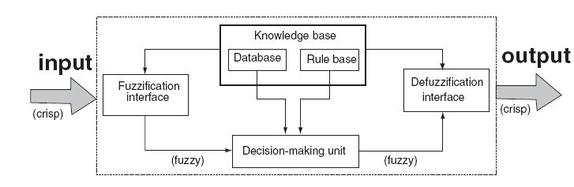
Fuzzy inference system

Slide 131
Different fuzzy inference techniques
Mamdani Fuzzy Inference
Sugeno Fuzzy Inference
Tsukamoto Fuzzy Inference

Slide 132
Mamdani Fuzzy Inference
The most commonly used fuzzy inference technique is the so-called Mamdani method.
In 1975, Professor Ebrahim Mamdani of London University built one of the first fuzzy systems to control a steam engine and boiler combination. He applied a set of fuzzy rules supplied by experienced human operators.
The Mamdani-style fuzzy inference process is performed in four steps:
Fuzzification of the input variables
Rule evaluation (inference)
Aggregation of the rule outputs (composition)
Defuzzification.

Slide 133
Mamdani Fuzzy Inference
We examine a simple two-input one-output problem that includes three rules:
Rule: 1 IF x is A3 OR y is B1 THEN z is C1
Rule: 2 IF x is A2 AND y is B2 THEN z is C2
Rule: 3 IF x is A1 THEN z is C3
Real-life example for these kinds of rules:
Rule: 1 IF project_funding is adequate OR project_staffing is small THEN risk is low
Rule: 2 IF project_funding is marginal AND project_staffing is large THEN risk is normal
Rule: 3 IF project_funding is inadequate THEN risk is high

Slide 134
Step 1: Fuzzification
The first step is to take the crisp inputs, x1 and y1 (project funding and project staffing), and determine the degree to which these inputs belong to each of the appropriate fuzzy sets.

Slide 135
Step 2: Rule Evaluation
The second step is to take the fuzzified inputs, μ_{(x=A1)} = 0.5, μ_{(x=A2)} = 0.2, μ_{(y=B1)} = 0.1 and μ_{(y=B2)} = 0.7,
and apply them to the antecedents of the fuzzy rules.
If a given fuzzy rule has multiple antecedents, the fuzzy operator (AND or OR) is used to obtain a single number that represents the result of the antecedent evaluation.
RECALL: To evaluate the disjunction of the rule antecedents, we use the OR fuzzy operation. Typically, fuzzy expert systems make use of the classical fuzzy operation union:
μ_{A∪B}(x) = max [μ_{A}(x), μ_{B}(x)]
Similarly, in order to evaluate the conjunction of the rule antecedents, we apply the AND fuzzy operation intersection:
μ_{A∩B}(x) = min [μ_{A}(x), μ_{B}(x)]

Slide 136
Step 2: Rule Evaluation

Slide 137
Step 2: Rule Evaluation
Now the result of the antecedent evaluation can be applied to the membership function of the consequent.
The most common method is to cut the consequent membership function at the level of the antecedent truth. This method is called clipping (alpha-cut).
Since the top of the membership function is sliced, the clipped fuzzy set loses some information.
However, clipping is still often preferred because it involves less complex and faster mathematics, and generates an aggregated output surface that is easier to defuzzify.
While clipping is a frequently used method, scaling offers a better approach for preserving the original shape of the fuzzy set.
The original membership function of the rule consequent is adjusted by multiplying all its membership degrees by the truth value of the rule antecedent.
This method, which generally loses less information, can be very useful in fuzzy expert systems.
Degree of
Membership
1.0
C
2
0.2
0.0
clipping
Z
Degree of
Membership
1.0
C
2
0.2
0.0
scaling
Z

Slide 138
Step 3: Aggregation of the Rule Outputs
Aggregation is the process of unification of the outputs of all rules.
We take the membership functions of all rule consequents previously clipped or scaled and combine them into a single fuzzy set.
The input of the aggregation process is the list of clipped or scaled consequent membership functions, and the output is one fuzzy set for each output variable.

Slide 139
Step 4: Defuzzification
The last step in the fuzzy inference process is defuzzification.
Fuzziness helps us to evaluate the rules, but the final output of a fuzzy system has to be a crisp number.
The input for the defuzzification process is the aggregate output fuzzy set and the output is a single number.
There are several defuzzification methods, but probably the most popular one is the centroid technique. It finds the point where a vertical line would slice the aggregate set into two equal masses. Mathematically this centre of gravity (COG) can be expressed as:

Slide 140
Step 4: Defuzzification
Centroid defuzzification method finds a point representing the centre of gravity of the aggregated fuzzy set A, on the interval [a, b ].
A reasonable estimate can be obtained by calculating it over a sample of points.

Slide 141
Sugeno Fuzzy Inference
Mamdani-style inference, as we have just seen, requires us to find the centroid of a two-dimensional shape by integrating across a continuously varying function. In general, this process is not computationally efficient.
Michio Sugeno suggested to use a single spike, a singleton, as the membership function of the rule consequent.
A singleton, or more precisely a fuzzy singleton, is a fuzzy set with a membership function that is unity at a single particular point on the universe of discourse and zero everywhere else.

Slide 142
Sugeno Fuzzy Inference
Sugeno-style fuzzy inference is very similar to the Mamdani method.
Sugeno changed only a rule consequent: instead of a fuzzy set, he used a mathematical function of the input variable.
The format of the Sugeno-style fuzzy rule is
IF x is A AND y is B THEN z is f(x, y)
where:
x, y and z are linguistic variables;
A and B are fuzzy sets on universe of discourses X and Y, respectively;
f (x, y) is a mathematical function.
The most commonly used zero-order Sugeno fuzzy model applies fuzzy rules in the following form:
IF x is A AND y is B THEN z is k
where k is a constant.
In this case, the output of each fuzzy rule is constant and all consequent membership functions are represented by singleton spikes.

Slide 143
Sugeno Rule Evaluation
1
1
1
1
1
1
A
B1
A3
3
B
1
0.1
0.1
0.1
OR
(max)
0.1
0.0
OR
0.0
(
max
0
)
0
0
0
0
x
1
0
x1
X
X
y
1
y1
Y
Y
k
1
k1
Z
Z
Rule 1: IF x is A3 (0.0) OR y is B1 (0.1)
Rule
1:
IF
x
is
A
3 (0.0)
OR
y
is
B
1 (0.1)
THEN
THEN z is k1 (0.1)
z
is
k
1 (0.1)
1
1
1
1
1
0.7
1
0.7
A2
B2
A
2
B
2
0.2
0.2
0.2
0.2
AND
AND
(min)
(
min
)
0
0
0
0
0
x
1
0
x1
X
X
y
1
y1
Y
Y
k
2
k2
Z
Z
Rule 2: IF x is A2 (0.2) AND y is B2 (0.7)
THEN z is k2 (0.2)
IF
x
is
A
2 (0.2)
AND
y
is
B
2 (0.7)
THEN
z
is
Rule
2:
k
2 (0.2)
1
1
1
1
A1
A
1
0.5
0.5
0.5
0.5
0
0
0
x
1
0
x1
X
X
k
k3
3
Z
Z
Rule
3:
Rule 3: IF x is A1 (0.5)
THEN z is k3 (0.5)
IF
x
is
A
1 (0.5)
THEN
z
is
k
3 (0.5)

Slide 144
Sugeno Aggregation and Defuzzification
COG becomes Weighted Average (WA)

Slide 145
Mamdani or Sugeno?
Mamdani method is widely accepted for capturing expert knowledge. It allows us to describe the expertise in more intuitive, more human-like manner. However, Mamdani-type fuzzy inference entails a substantial computational burden.
On the other hand, Sugeno method is computationally effective and works well with optimization and adaptive techniques, which makes it very attractive in control problems, particularly for dynamic nonlinear systems.

Slide 146
Advantages of the Sugeno method
It is computationally efficient.
It works with linear techniques.
It works well with optimization and adaptive techniques.
It has guaranteed continuity of the output surface.
It is well suited to mathematical analysis.

Slide 147
Advantages of the Mamdani method
It is intuitive.
It has widespread acceptance.
It is well suited to human input.

